Slide 1

GI X-Sell In-depth EDA Travel and Home Insurance

Slide 2
Executive Summary
Jacky
We have done the exploratory data analysis (EDA) on the GI travel data (from 2017 to 2023) with the L&H data.
Some of the key findings:
Signing up L&H insurance rate given there were travel insurance claims before is 8.5%, a 1.7% increase over no travel insurance claims (rephrase it, [1] significantly higher + [2] specific for SOMETHING (e.g. agent channel or medical?) )
…
…
Possible approaches to do GI X-sell Travel-to-Medical
[Claim-to-L&H-different-products] …
[Propensity] Out of the 17500 possible customers, ~13800 has AXA Agent as their primary channel. Dependent on the customers' features (i.e. Claim, GI policy duration, GWP, etc) devise a plan for the agent to reach out said customers on a tiered approach.
Next step
To continue to test & fine tune propensity to buy models to improve potential customer capture rate.

Slide 3





Data Source in detail
Kelvin follow
Kin refine first
Extraction Date: Feb 2023
Basestat
Client data
Source | Data | Num. of rows | Num. of columns | Period | Extraction Date
GI | Basestat (Aggregation of prembase + clambase) | 5,257,817 | 116 | (2015, 2023) | 2023/02
 | Clambase | 237,406 | 364 | (1998, 2023) | 2023/02
 | Client | 6,323,751 | 10 | (1900, 2023) | 2023/02
 | Prembase (Only used column “age”) | 5,031,178 | 79 | (1998, 2023) | 2023/02
L&H | Application & Policy | 247,3507 | 85 | (1990, 2023) | 2023/03
Left join with client num.(COWNNUM, CLNTNUM)
Basestat + Client
Clambase
Left join with policy num. (contrnb)
Basestat + Client + Claim
L&H
Left join with client ID. (modified_SECUITYNO, modified_owner_id)
Basestat + Client + Claim + L&H

Slide 4
Data Statistics
Jacky
# of unique clients in Travel Insurance: 740,254
# of unique policy: 2,297,703
Top 5 product by # of policy:
TravelSurance (single trip) - 1,051,768
SmartTraveller (Single) - 600,259
Single Trip 2018 – 361,345
SmartTraveller Plus (Single) – 89,374
SmartTraveller (Annual) – 48,104
Sum of GWP: 1,366,492,202
Average GWP: 594.72
Top 5 product by GWP:
TravelSurance (single trip) - 267,748,000
MultiTrip TravelSurance (Annual) 249,814,800
SmartTraveller (Single) - 198,794,900
SmartTraveller (Annual) - 182,615,900
Single Trip 2018 - 142,949,400
Note: this is the total period

Slide 5
We have investigated from different angles
Kelvin
Based on channels
New policies per year
New policies per quarter (average) pre/during/post Covid
Based on product
Single/Annual trip products by channel and pre/during/post Covid
Travel duration of single trip product pre/during/post Covid
Based on age
Age group distribution per year
Age of first purchase of L&H plans
Based on gender
Gender distribution by channel and by year
Based on claims in travel
Buy L&H chances of different channels within x years of claim/bought GI
With Claims types and the rate of buying L&H
Correlation between features
Correlation Matrix with highly correlated features with buying L&H and claimed previously

Slide 6
Based on channels

Slide 7
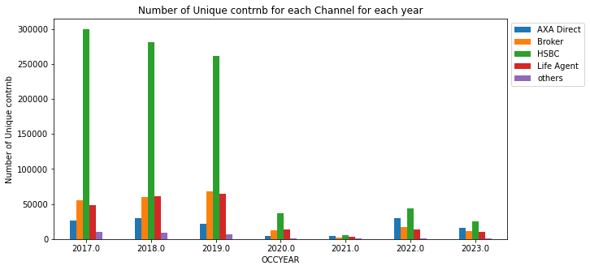
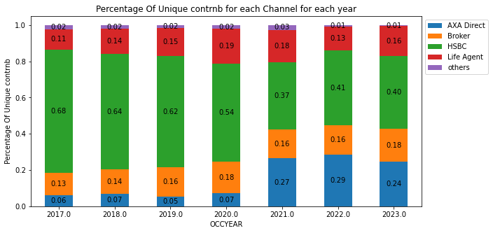
Number of new policies of each channel per year
Kelvin
There is a huge drop in 2020 due to covid.
AXA Direct(Blue) has an increasing coverage % during 2021-2022, yet HSBC still has the highest number of clients who bought new policies between 2020-2022.
Notes:
Channel
Other: Citi and JLT

Slide 8
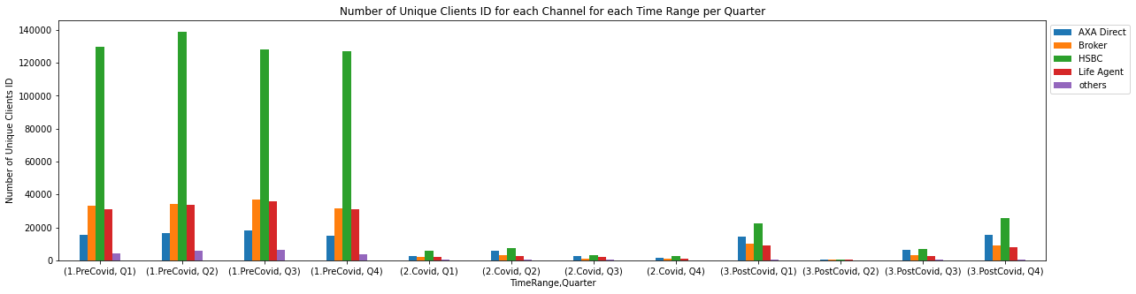
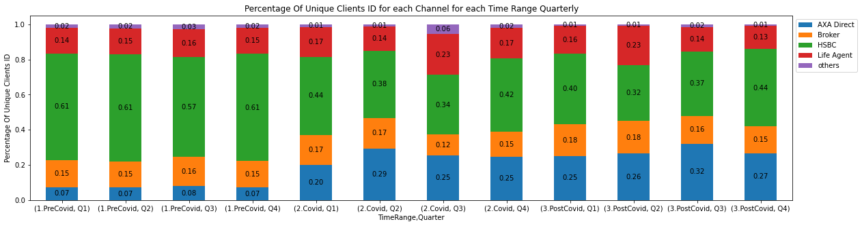
Number of new policies of each channel per quarter (average) pre/during/post Covid
Kelvin
Notes:
Channel
Other: Citi and JLT

Slide 9
Based on products

Slide 10
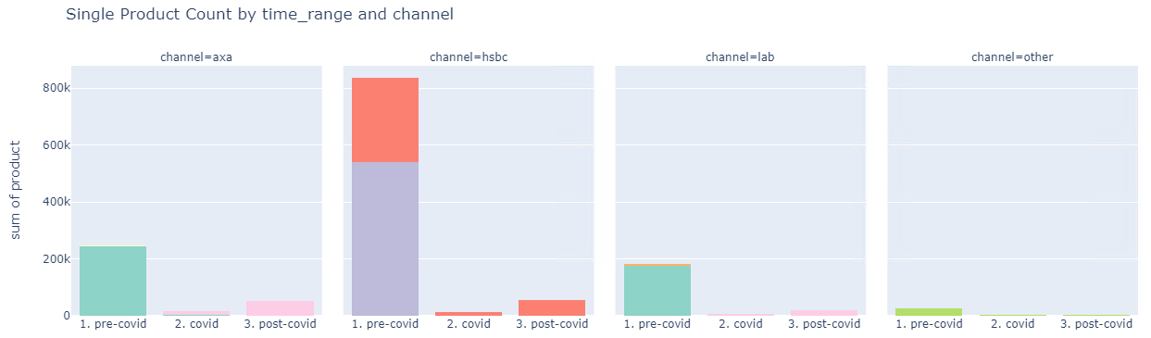
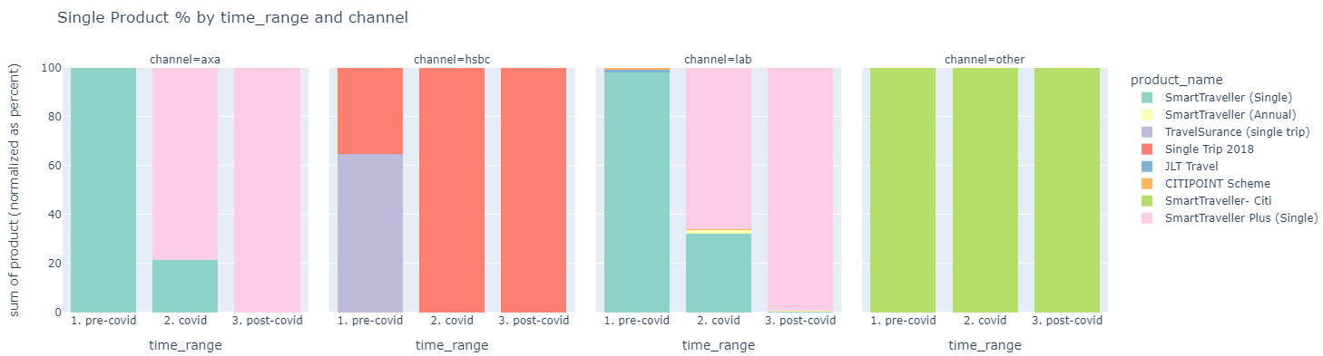
Single Trip Product Distribution by channel and pre/during/post Covid
Kelvin
Observation
Huge drop in number of policies after covid.
For AXA, LAB and other channels, most clients shifted to SmartTraveller Plus after covid happens
Notes
SmartTraveller (Annual) should not be included here
Time range:
Pre-Covid: Jan 2017 - Feb 2020
Covid: Mar 2020 – Jun 2022
Post-Covid Jun 2022 - Now
Channel:
Other: Citi, JLT

Slide 11
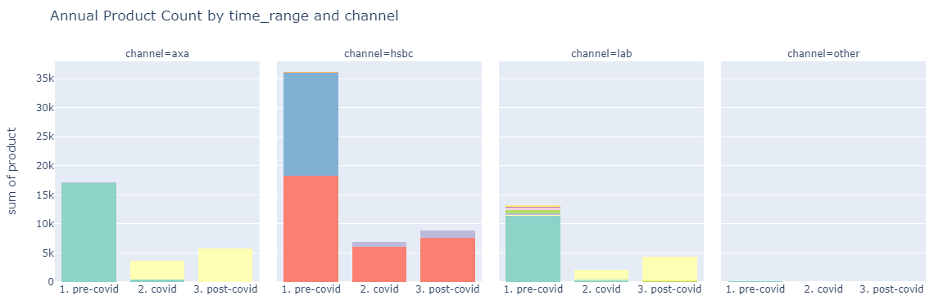
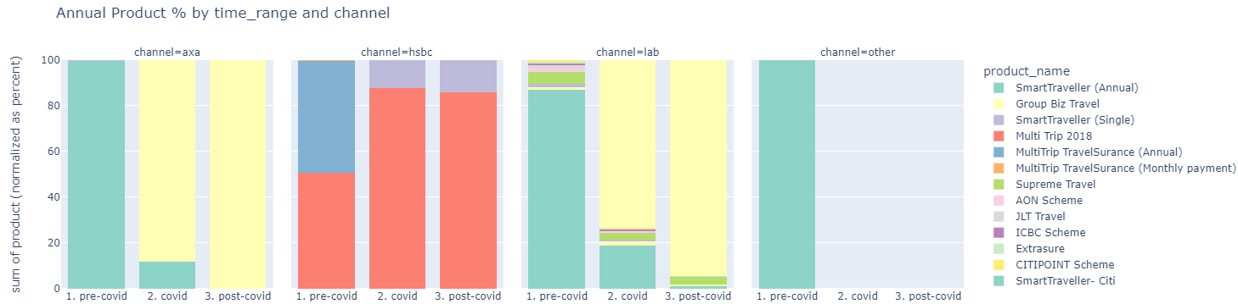

Annual Trip Product Distribution by channel and pre/during/post Covid
Kelvin
Observation
Compared to single trip, the percentage drop in number of annual policies after covid is smaller.
Similarly, for AXA and other channels, most clients shift to SmartTraveller Plus after covid happens.
For HSBC, there is an increase trend in student insurance.
Overseas StudySurance
Overseas StudySurance
SmartTraveller
Plus (Annual)
SmartTraveller
Plus (Annual)
Notes
SmartTraveller (Single) should not be included here
Time range:
Pre-Covid: Jan 2017 - Feb 2020
Covid: Mar 2020 – Jun 2022
Post-Covid Jun 2022 - Now
Channel:
Other: Citi, JLT
SmartTraveller
Plus (Annual)
SmartTraveller
Plus (Annual)

Slide 12
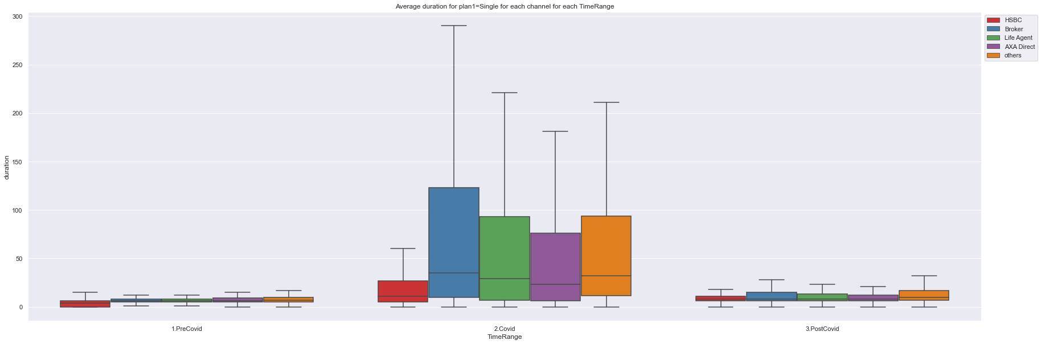
Average duration for single trip travel plan
Kelvin
Observation
The travel duration for single trip is the highest during covid

Slide 13
Based on age

Slide 14
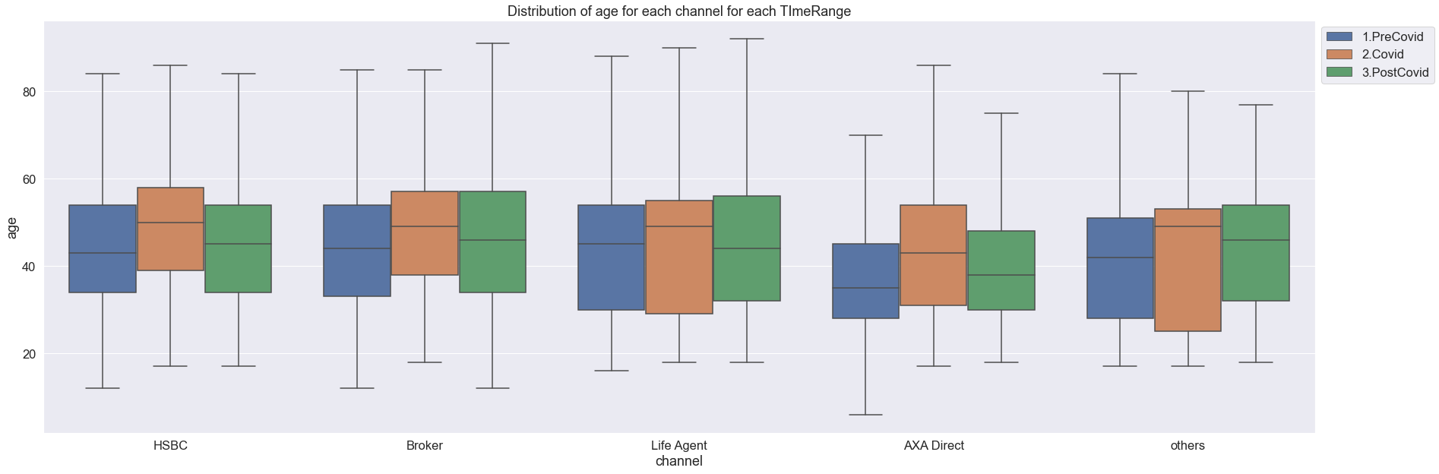
Age Distribution by channel and pre/during/post Covid
Kelvin
Observation
There is an increase in the average age of traveler during Covid. However, after covid, the distribution becomes like pre-covid.

Slide 15
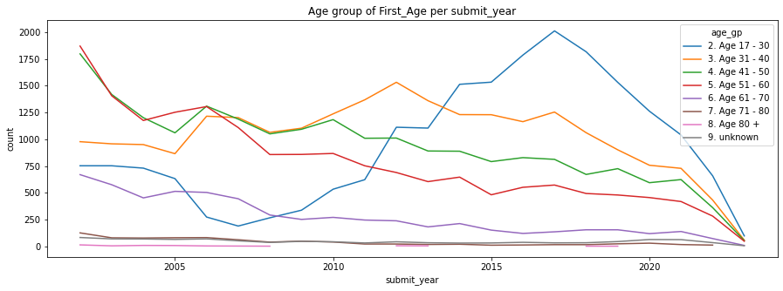
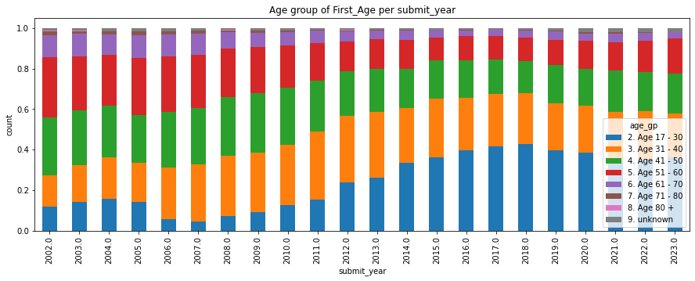
First – time bought–LH-age group distribution (2002-2023)
Kelvin
Observation
Since around 2012, the Age group of first-time-buying-LH has most increased in the age group of 17-30, more young people are gaining more awareness on LH insurance products.

Slide 16
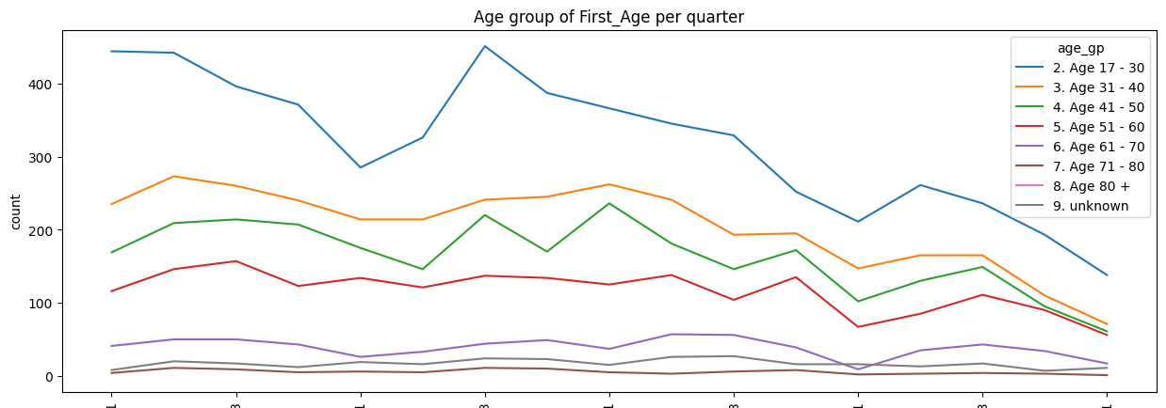
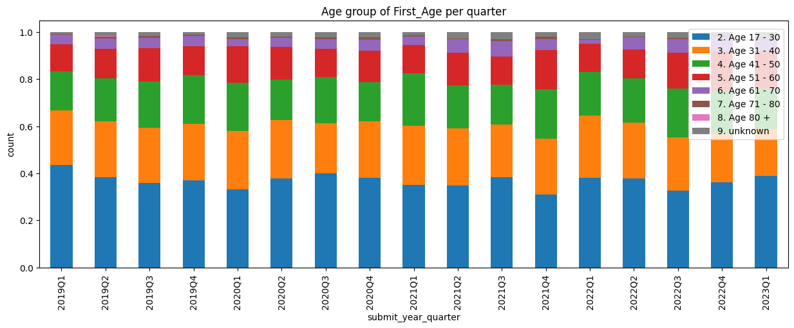
First – time bought–LH-age group distribution (2019-2023)
Kelvin
Observation

Slide 17
Based on gender

Slide 18
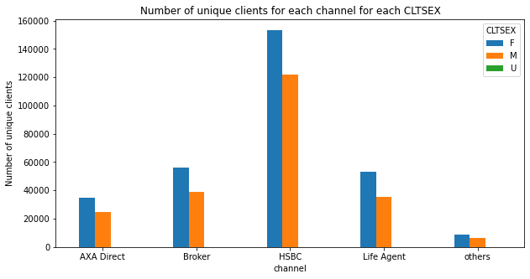
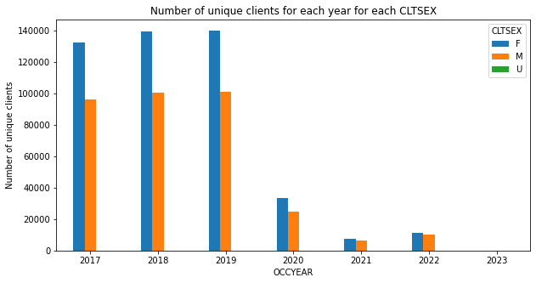
Gender distribution by channel and by year
Kelvin
Observation
Female is more likely to buy insurance than male for GI travel insurance.

Slide 19
Based on Claims

Slide 20
Claim Statistics & Insight
Jacky
Key Insights:
Unsuccessful claims had no noticeable impact on Travel insurance cancellation (~3%)
Signing up L&H insurance rate given there were travel insurance claims before: 8.5%
Signing up L&H insurance rate given there was no travel insurance claims: 6.8%
Key noticeable GI features that impacted Travel-Claim-to-Medical pipeline:
GI sign up channel
GI products
Claims
No noticeable effects: claim amount, claim category, claim payment amount, GWP amount given there is claim(s)
Out of users who followed Travel-Claim-to-Medical pipeline, ~36% of the such users subscribed to a L&H product within 1 year.
Need to re-confirm
Jacky – Confirmed

Slide 21
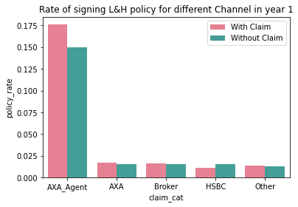
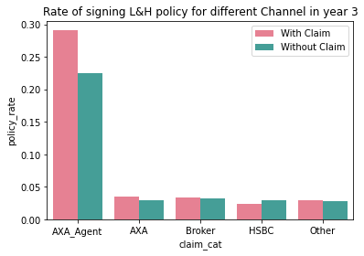
Claim Breakdown – Group
Jacky
With Claim Breakdown
year | Group | Policy rate | Claim with L&H | Claim with no L&H
1 1 1 1 1 | HSBC | 0.0107 | 575 | 53939
1 | Broker | 0.0163 | 329 | 20241
1 | AXA_Agent | 0.1763 | 3291 | 18668
1 | AXA | 0.0171 | 192 | 11196
1 | Other | 0.0134 | 38 | 2834
3 3 3 3 3 | HSBC | 0.024 | 1296 | 53939
3 | Broker | 0.0344 | 696 | 20241
3 | AXA_Agent | 0.2913 | 5438 | 18668
3 | AXA | 0.0355 | 397 | 11196
3 | Other | 0.0289 | 82 | 2834
Without Claim Breakdown
year | Group | Policy rate | No Claim with L&H | Claim with no L&H
1 1 1 1 1 | HSBC | 0.0156 | 6254 | 402037
1 | Broker | 0.0156 | 2220 | 142434
1 | AXA_Agent | 0.1494 | 17270 | 115600
1 | AXA | 0.0149 | 1358 | 90926
1 | Other | 0.0131 | 254 | 19408
3 3 3 3 3 | HSBC | 0.0301 | 12086 | 402037
3 | Broker | 0.0326 | 4637 | 142434
3 | AXA_Agent | 0.2254 | 26056 | 115600
3 | AXA | 0.0293 | 2665 | 90926
3 | Other | 0.0285 | 553 | 19408

Slide 22
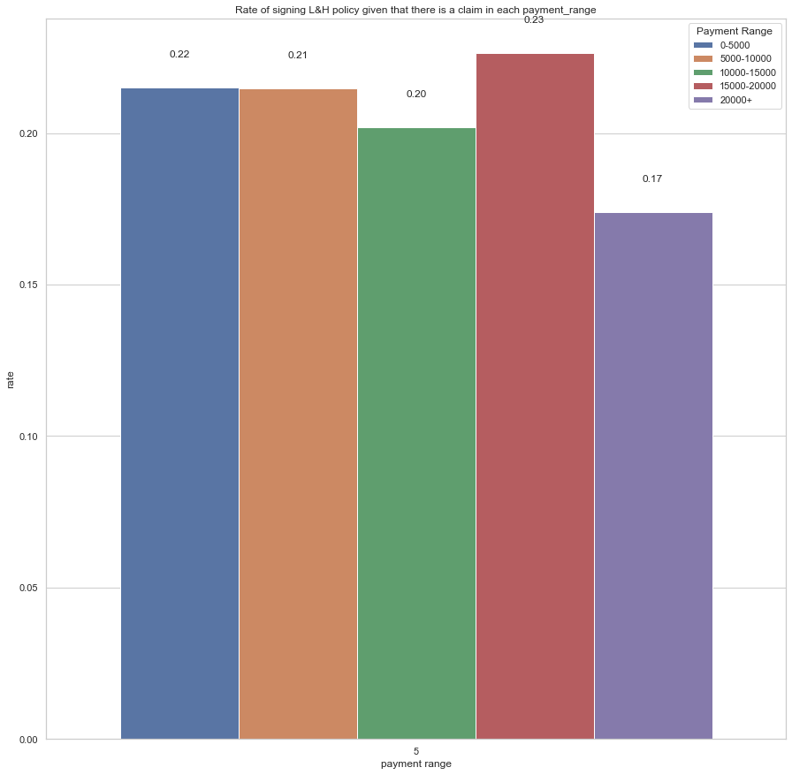

Claims breakdown – Payment Range
Jacky
Payment is the Claim payment
No significant impact on L&H signup

Slide 23
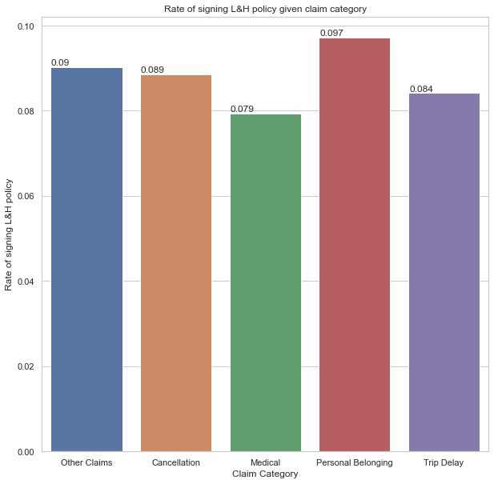
Claims breakdown – Claim Category
Jacky
Note: Other category includes: Emergency Assistance, Personal Accident, Third Parties Personal Liability. We group them because the population size were significantly smaller than the other categories
No noticeable effects on L&H given different categories of claims
No noticeable effects on L&H when there are multiple different categories of claims ( <1%)

Slide 24
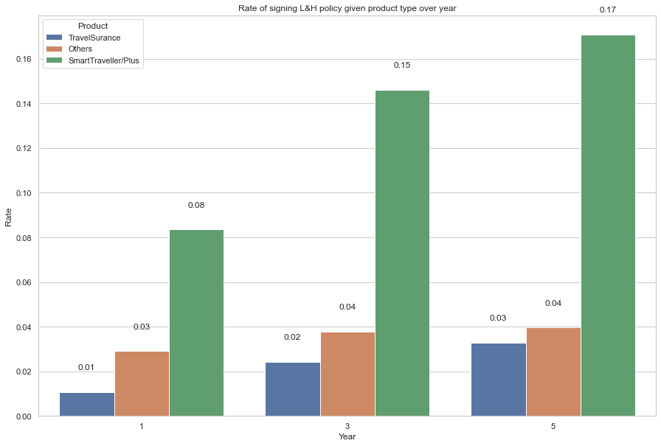
Claims breakdown – Product
Jacky
SmartTraveller and SmartTraveller + have a impact on L&H sign up. This is correlated to the channels since SmartTraveller product is sold directly by AXA or AXA agent

Slide 25
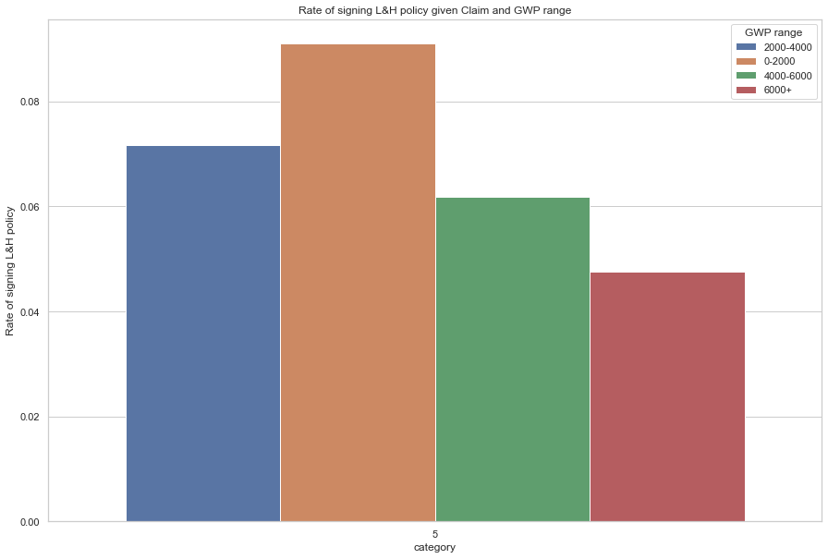
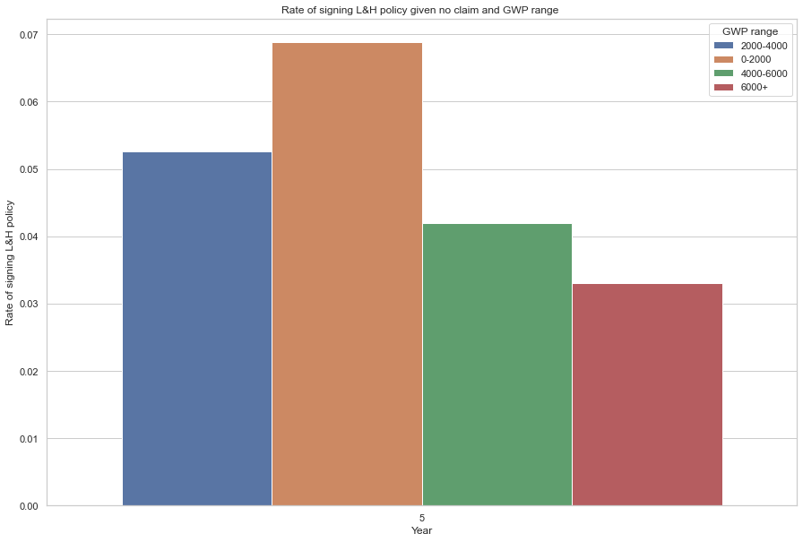
Claims breakdown – GWP
Jacky
There is no significant impact on L&H given various levels of GWP when there is a claim or no claim

Slide 26
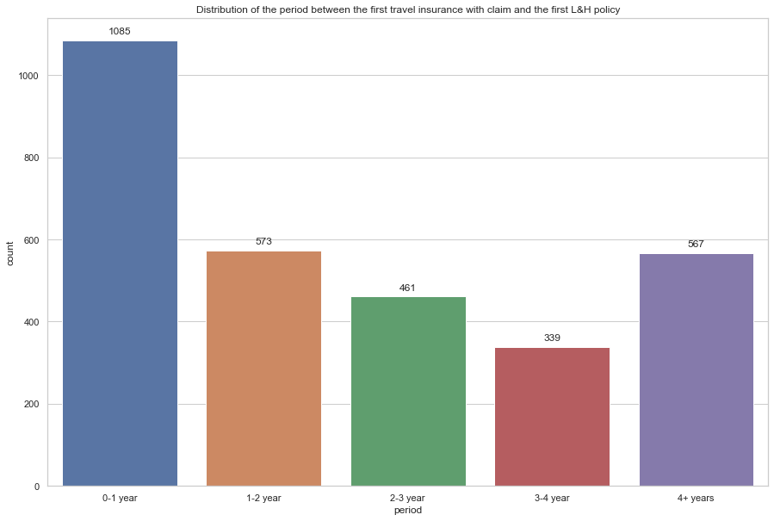
Claim Breakdown– Time Distribution
Jacky
Majority of customers subscribe L&H within the first year of making a claim(~36%)

Slide 27
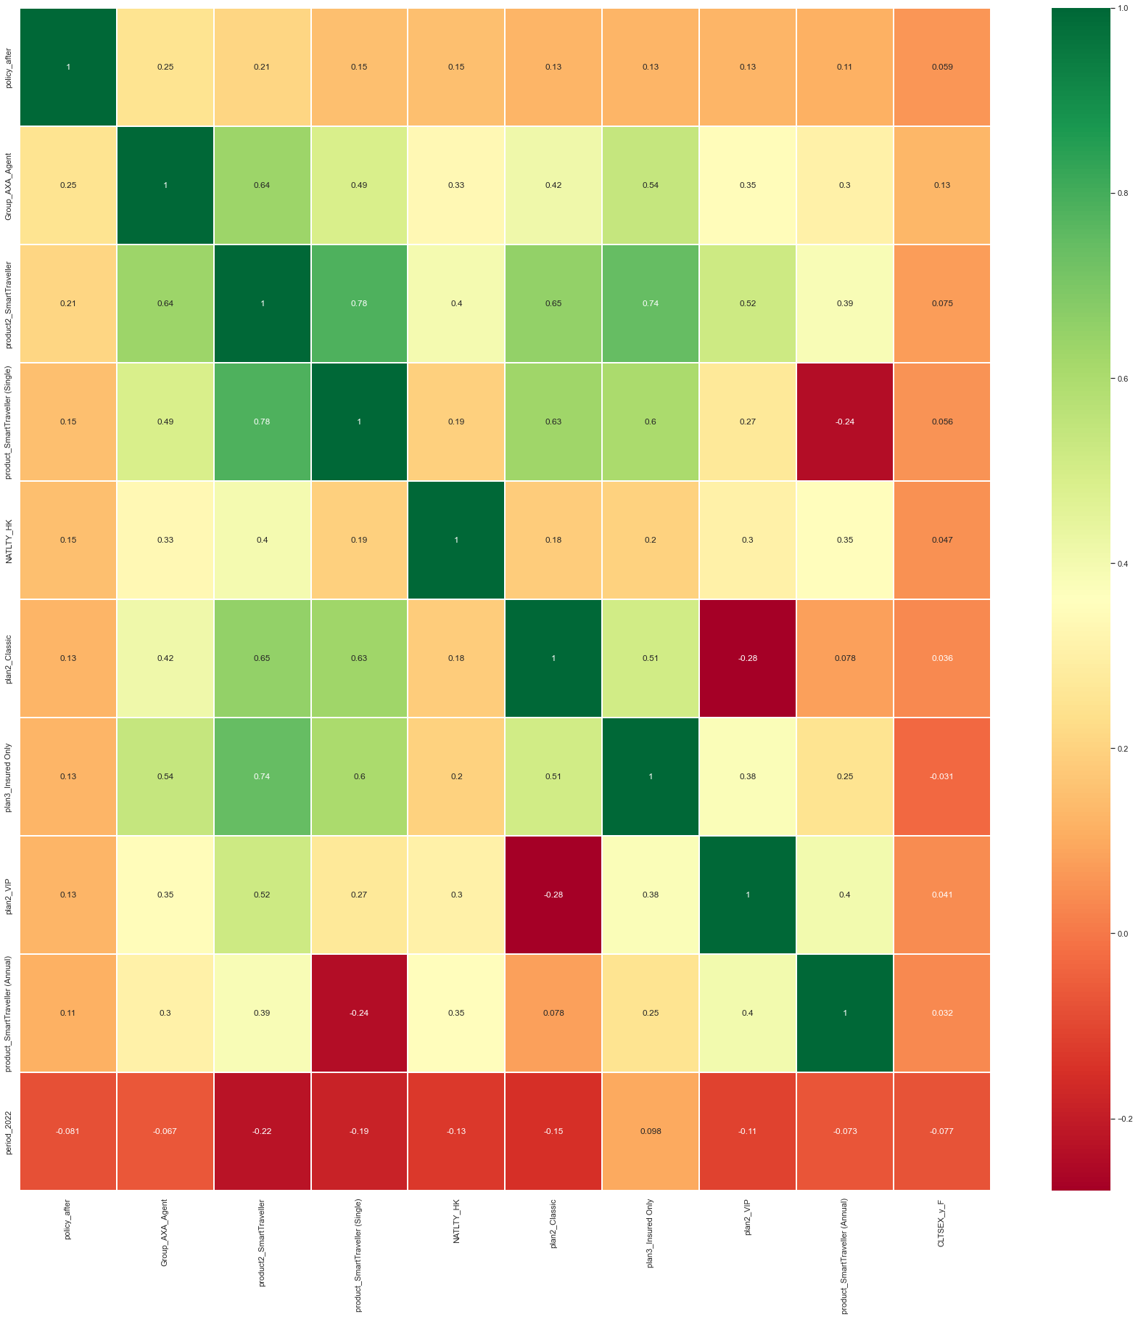
Supporting Document – Correlation Matrix
Jacky
Key linear correlation between having L&H are:
Channel = AXA Agent
Product =SmartTraveler

Slide 28
Projection Estimation for GI X-sell travel-to-medical

Slide 29
Bought-medical rate after claimed in different channels
[Graphs + Table]
The difference between Life Agent channel and other channels
How much uplift we can do for the rest of the channels and maybe also for Life Agent Channel by the campaign

Slide 30
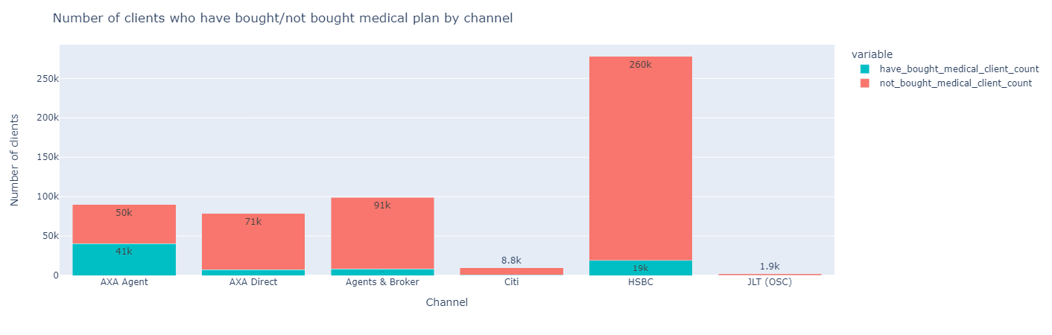
Bought-medical rate after claimed in different channels
Bought/not bought medical plan after claimed
Kelvin

Slide 31

Bought-medical rate after claimed in different channels
Bought/not bought medical plan of no claim client number (no chronological order)
Kelvin

Slide 32
Bought-medical effect after claimed in different channels
Kelvin
5-year observation period data for claim/no claim and buying medical relationship of all time
For AXA Agent, the odds of buying L&H products of clients with travel claim is ~30% more than those without travel claim within 3 years after claim
We can promote to other channels to utilize the travel claim experience of GI clients
To calculate the ~30% effect circled in red.
Example of calculating the buying effect
Claimed travel then bought L&H | No claim travel then bought L&H | Formula | Buy L&H effect
29.1% | 22.5% | (29.1%/22.5%) -1 | 29.3%

Slide 33
Uplift of claimed clients from other channels
Kelvin
With last 5-year data only (2018 and after data)
Channel | Clients who claimed after 2018 | Clients who claimed after 2018, then bought L&H within 5 yrs | Claimed then bought L&H % | Had GI after 2018 without claim, then bought L&H within 5 yrs | No claim then bought L&H % | Ratio between claim/no claim, then bought L&H | Clients claimed but not yet bought L&H | No claim but not yet bought L&H | Uplift % from claimed clients | Uplift count
AXA Agent | 13,055 | 3,968 | 30% | 20,542 | 24% | 25% | 9,087 | 64,196 | NA | NA
AXA Online Direct | 7,671 | 258 | 3.3% | 2,114 | 3.0% | 10% | 7,413 | 69,255 | +0.6% | 44
AXA Offline Direct | 541 | 40 | 7.4% | 166 | 6.2% | 19% | 501 | 2,506 | +0.66% | 3
Broker | 11,844 | 431 | 3.6% | 2,947 | 3.2% | 13% | 11,413 | 89,671 | +0.56% | 64
HSBC | 31,156 | 837 | 2.7% | 8,091 | 3.0% | -10% | 30,319 | 258,449 | +1.2% | 364
Others | 1,783 | 71 | 4.0% | 355 | 3.3% | 21% | 1,712 | 10,128 | +0.29% | 5
Total uplift |  |  |  |  |  |  |  |  |  | 480
*Notes:
AXA Direct has a 60% opt-in rate

Slide 34
Propensity-to-buy model
[All channel sizes within 5 years – Graphs + Tables]
Quick baseline model (maybe a random forest) (X features without claim data, y is bought-medical)
➔ Make the estimation of the size of converted customers within our 5 years
(If we just use the estimation where customer who brought from AXA Agent, there is around 50% chance of them buying L&H in their life time. This will yield us 8843 customer for conversion. If we use 30%( that statistics that AXA Agent -> Claim -> Life&), it will be 5306 customer for conversion

Slide 35
Possible approaches to do GI X-sell Travel-to-Medical
Jacky
Make strategic plans for targeting claimed customers……
Make a propensity model to select higher propensity-to-buy customers….

Slide 36
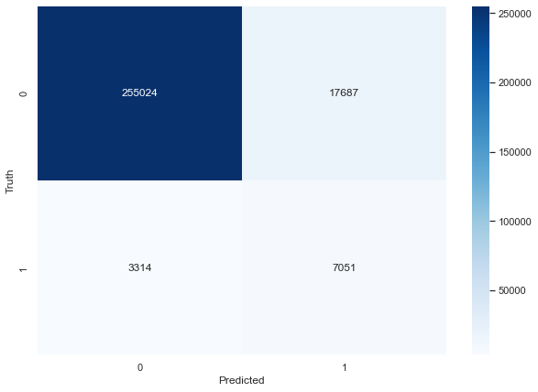
Propensity-to-buy model – Only Medical – Using the last-5-year customers for prediction
Jacky
Confusion Matrix
Baseline model’s prelim result
Precision score of 0.28
Recall score of 0.68
Based on our intial baseline model, we have around 17,500 customer that have the propensity to buy L&H
➔ if 5% conversion: 875

Slide 37
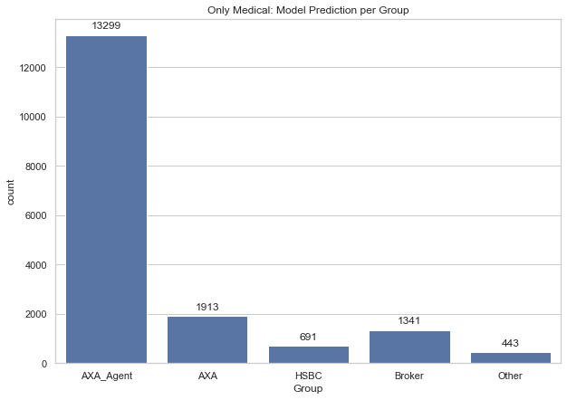
Propensity-to-buy model – Only Medical
Jacky
People to contact broken down by group
AXA agent has the highest population to contact which is align with our overall finding.

Slide 38
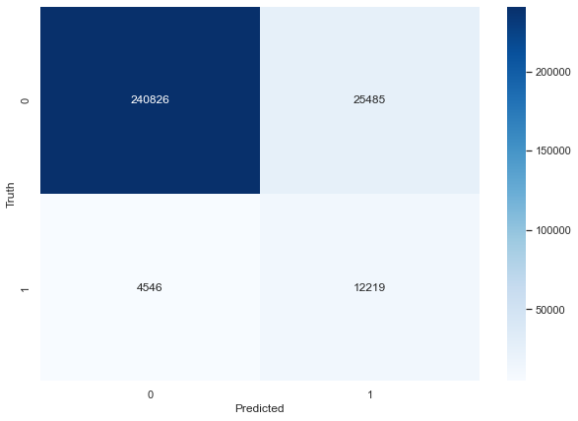
Propensity-to-buy model – Life and Health
Confusion Matrix
Baseline model result:
Recall score: 0.72
Precision score: 0.32
Based on our initial baseline model, we have around 25,000 customer that have the propensity to buy L&H for targeting. We will then select the higher propensity among them to promote.

Slide 39
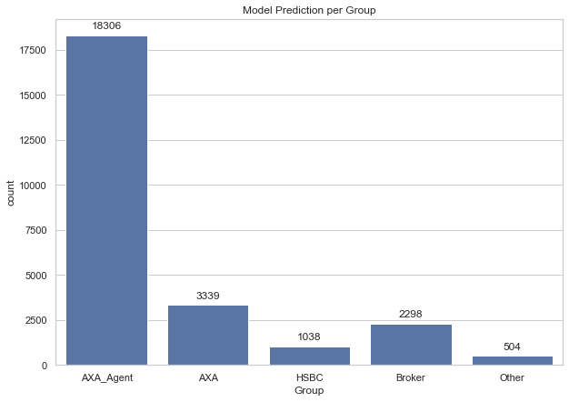
Propensity-to-buy model – Life and Health
People to contact broken down by group
AXA agent has the highest population to contact which is align with our overall finding.

Slide 40
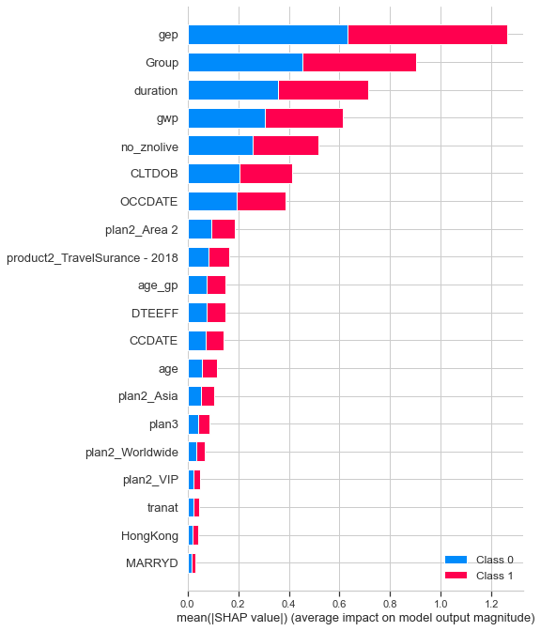
Propensity-to-buy model - Sharp
Jacky
Feature Importance
The baseline model of choice is LightGBM
Using the Shap values, we can see that gep and Group(Channels) are the most important features for the model.
This is aligned with our other findings where various channels will have high impact on costumers propensity to buy Life and Health

